Slide 1
Link State Routing Protocol
Simulator
Madhumitha Karthikeyan
A20310012

Slide 2
Agenda
Simulator objective
Link state Routing Protocol
Dijkstra’s Algorithm-Shortest path
Operations
Results and Discussion

Slide 3
Simulator Objective
To output the connection table of any router, and output the optimal path between any two selected routers
To reroute when any router goes down.

Slide 4
Link State Routing Protocol
Link-state routing protocols are one of the two main classes of routing protocols used in packet switching networks for computer communications, the other being distance-vector routing protocols.
Examples of link-state routing protocols include open shortest path first (OSPF) and intermediate system to intermediate system (IS-IS).
The basic concept of link- state routing is that every node constructs a map of the connectivity to the network, in the form of a graph, showing which nodes are connected to which other nodes.
Each node then independently calculates the next best logical path from it to every possible destination in the network. The collection of best paths will then form the node's routing table

Slide 5
Dijkstra’s Algorithm
Dijkstra’s algorithm is an algorithm for finding the shortest paths between nodes in a graph.
For a given source node in the graph, the algorithm finds the shortest path between that node and every other.
It can also be used for finding the shortest paths from a single node to a single destination node by stopping the algorithm once the shortest path to the destination node has been determined

Slide 6
Operations
Create a Network Topology
Build a Connection Table
Shortest Path to Destination Router
Modify a topology
Exit
Extra Credits:
Accepts a minimum input of 8 routers
Displays the connection table for all routers as default.

Slide 7
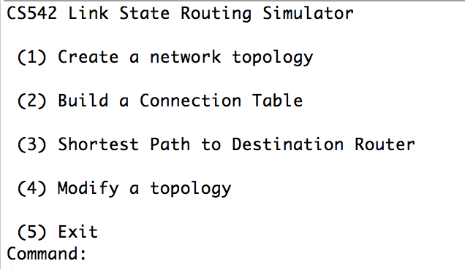
Results and Discussion
Menu:
The program is compiled and outputs the menu below.
The user can give his choice from 1-5

Slide 8
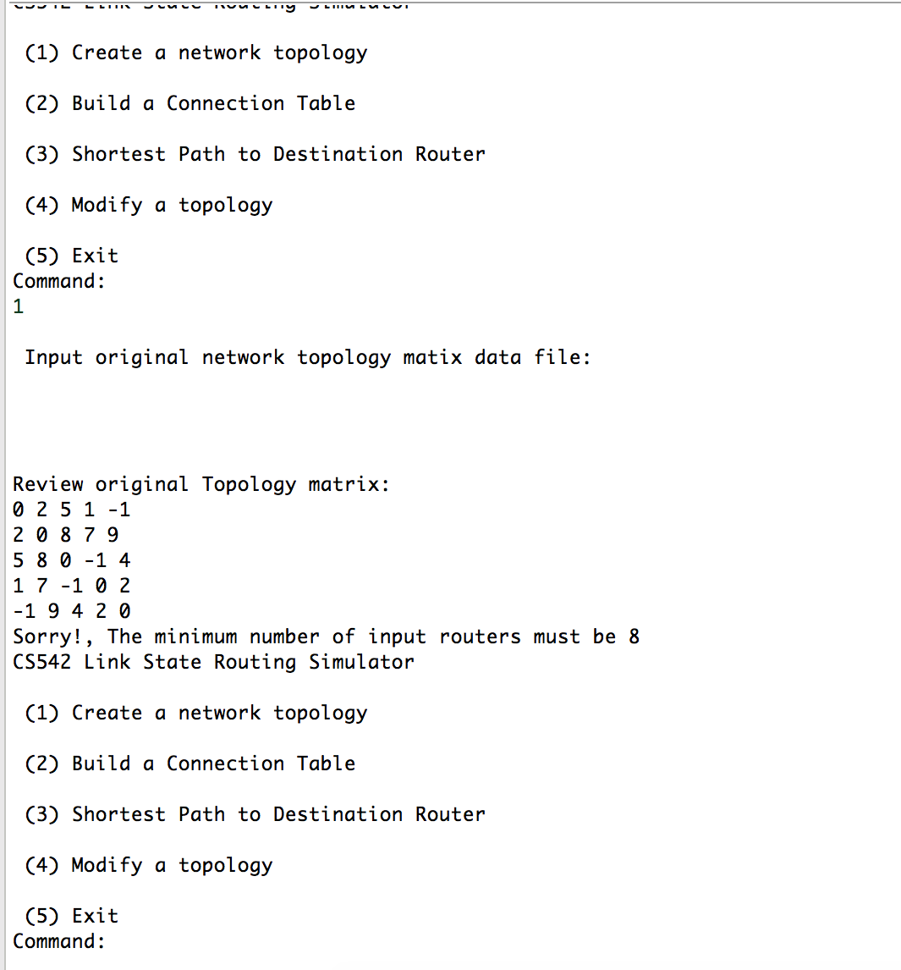
Results and Discussion Contd’
The input file, topology.txt has the original topology matrix.
Extra Credit: Will accept only a minimum of 8 routers.
0 2 5 1 -1 3 2 1
2 0 8 7 9 1 2 3:
5 8 0 -1 4 1 1 1
1 7 -1 0 2 1 2 3
-1 9 4 2 0 2 3 4
3 1 1 1 2 0 2 3
2 2 1 2 3 2 0 -1
1 3 1 3 4 3 -1 0

Slide 9
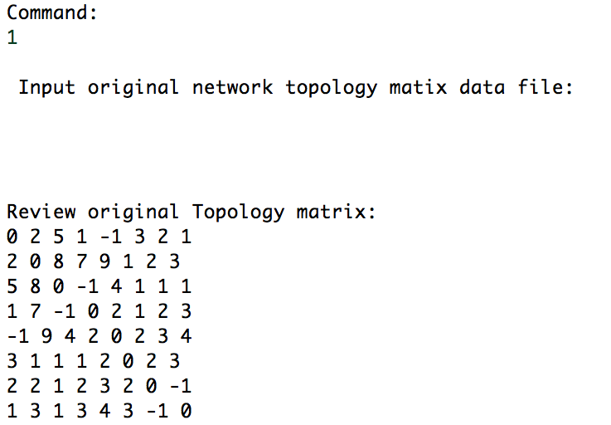
Results and Discussion Contd’
Menu:
When the user inputs 1, the topology.txt file is read and it is displayed to the user. Internally, it is stored in a matrix. Then it returns to the menu.

Slide 10
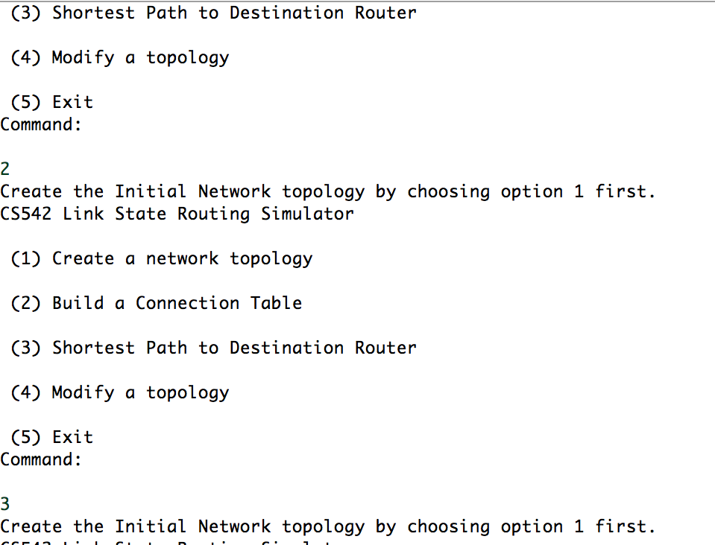
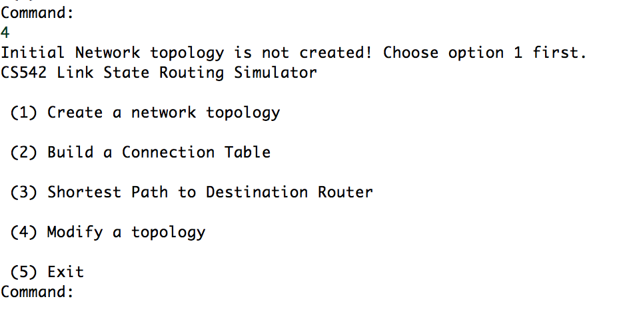
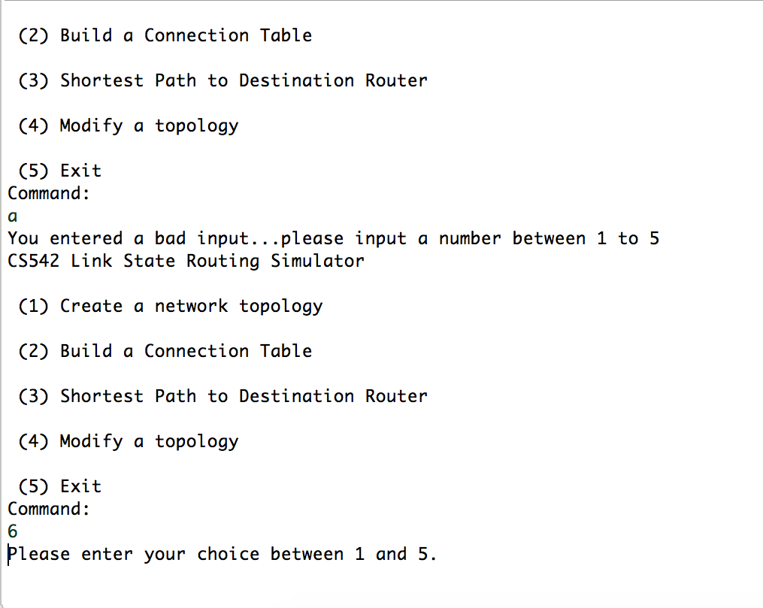
Results and Discussion Contd’
Create a Network Topology :
When the user tries to give options 2,3,4 to perform operations without reading the input. The program doesn’t allow it and asks the user to choose option 1 to create the input topology first.
If the user inputs anything other than a number or a number more than 5, the program indicates the user to pick the choice from 1-5 and displays the menu again

Slide 11
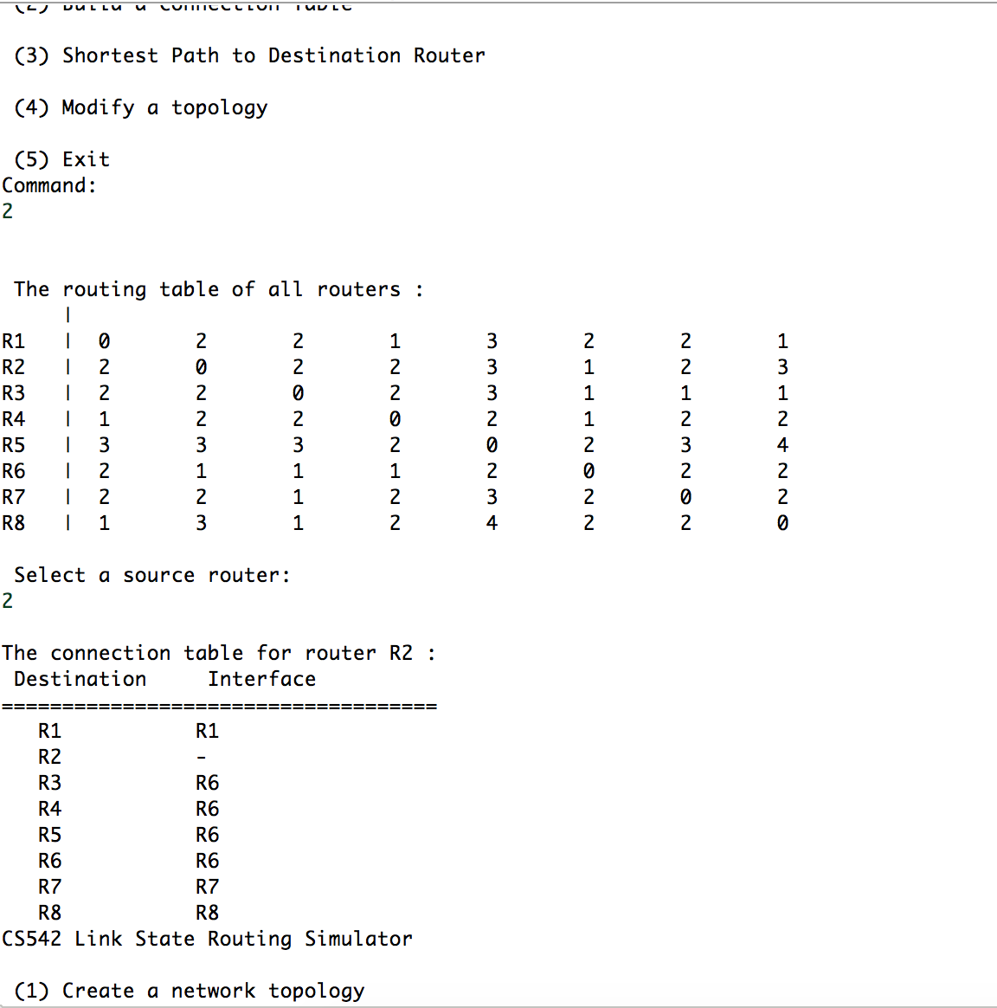
Results and Discussion Contd’
Extra credit: Create a connection table of each node as default and display all
When the user inputs option 2, it outputs the routing table of all the routers using dijstra’s algorithm by default and asks for a source router and displays the connection table for that router with the interface to the destination from that source.

Slide 12
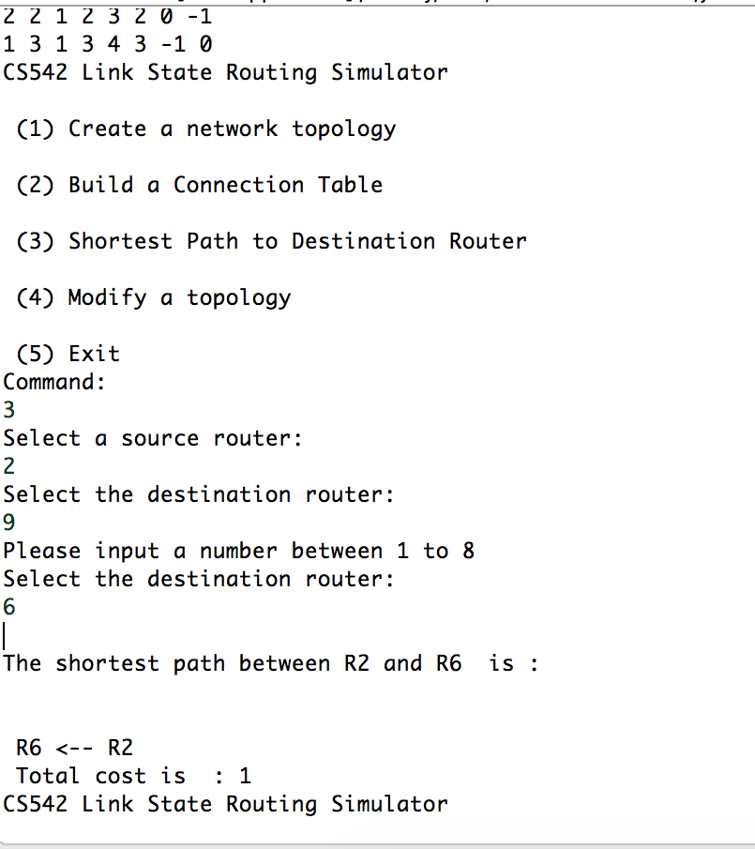
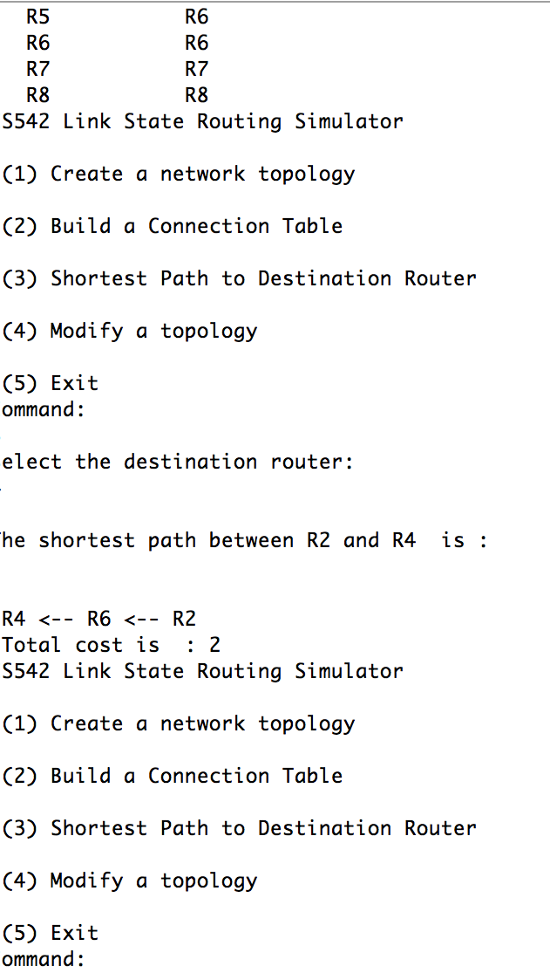
Results and Discussion Contd’
Path and Cost :
When the user inputs option 3 , the source router is taken from the previous input and the destination router is got from the user. If the previous option is not selected, it gets fresh from the user.The shortest path is found out with dijkstra’s algorithm and the cost from the source to destination is calculated and it is outputted to the user. Then it returns to the menu.f the user inputs a number more than the number of routers for source or router, the program indicates that to the user and allows them to input the desired router number.

Slide 13
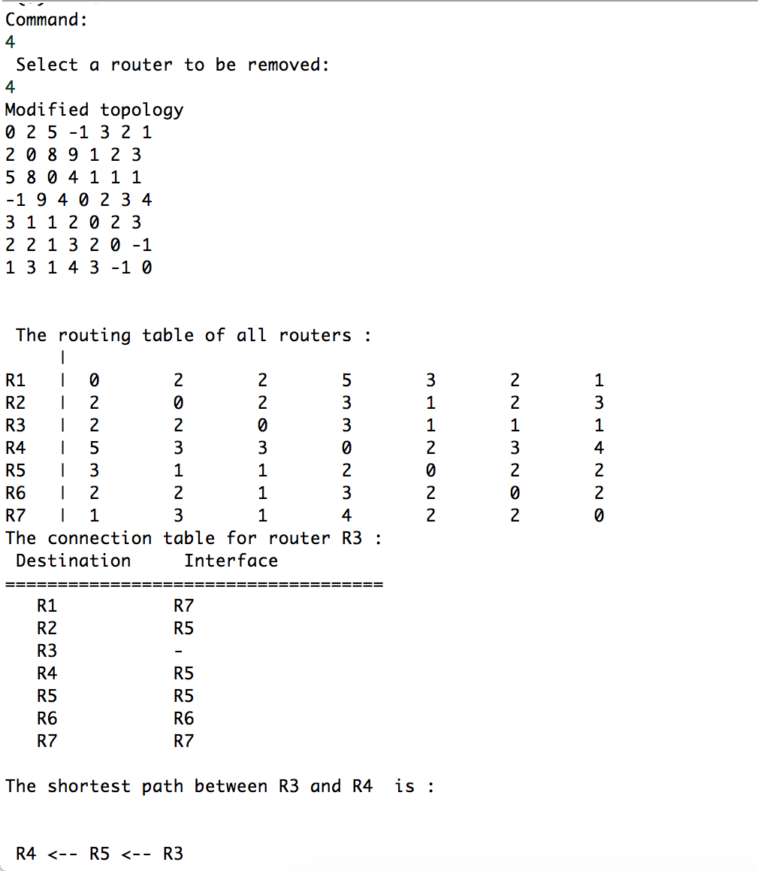
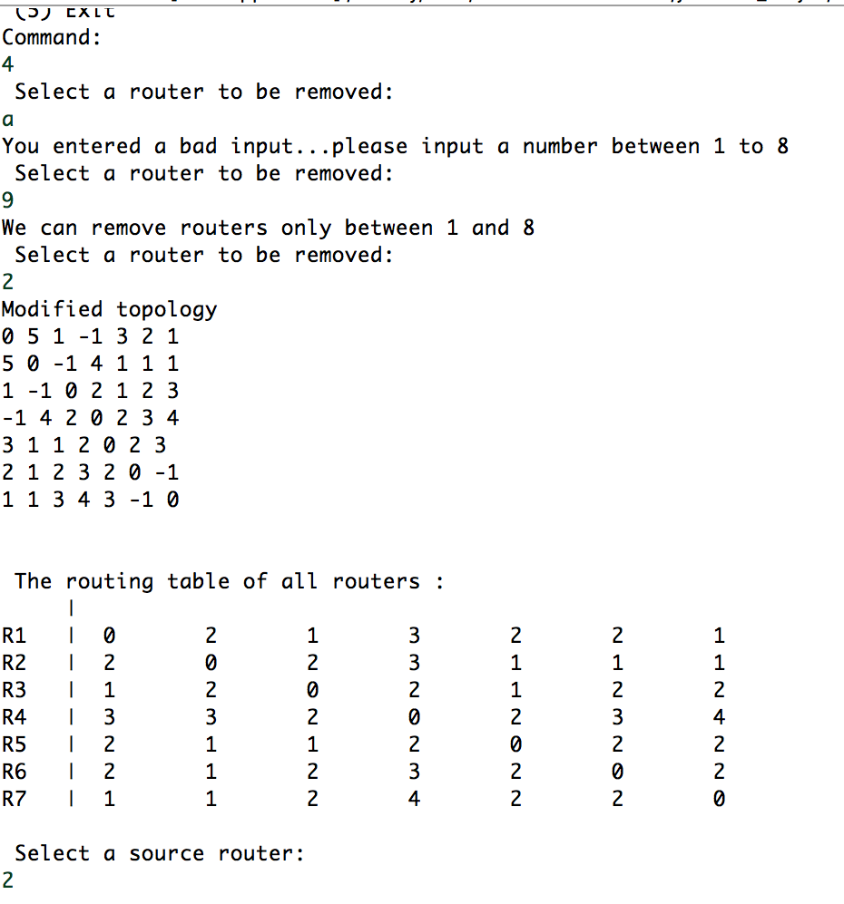
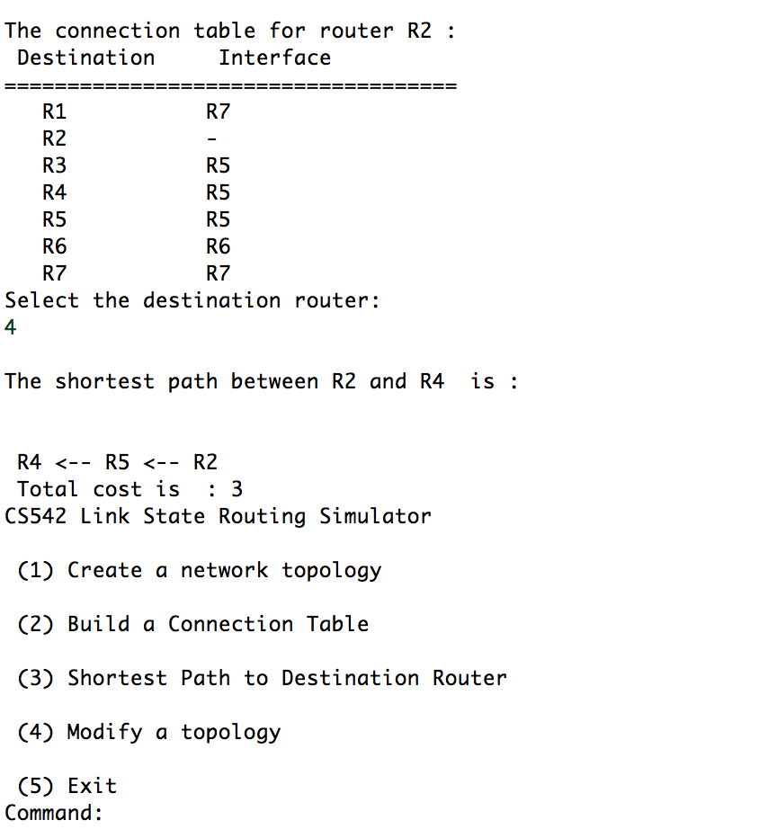
Results and Discussion Contd’
Modify Topology:
When the user gives the input option 4 , it takes asks for the router to be removed, if the user inputs a router more than the number of routers or a non integer, it doesn't allow and re asks it to the user. The source and destination routers are taken from the previous options and the new topology matrix , connection table from the source to destination, the new path and cost are displayed automatically.

Slide 14
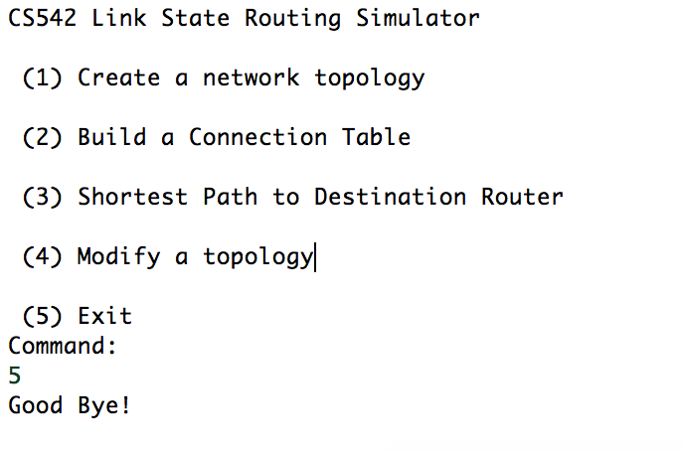
Results and Discussion Contd’
Exit:
When the user selects option 5, the program outputs, Goodbye! and terminates.

Slide 15
Thank you!

